Slide 1

Blue Eye Technology
AI | Brain Computer Interface
Information Technology Department,
St. Joseph’s College of Engineering
By, ENUSHA M

Slide 2
Table of Contents
Introduction
The Etymology of the Blue Eyes
Historical Background
Need for the Blue Eyes Technology
Benefits of the Blue Eyes Technology
Conclusion

Slide 3




I NTR OD U CTI ON
What I’ll illustrate in this Presentation :
Basic Understanding about the AI in Blue Eye Technology.
Using Human Recognization in the filed of Brain Computer
Interface and AI.
Pinpointing the perceptual capabilities of this technology to understand each other’s emotional level or feelings.
Links:
https://youtu.be/bO19eEMQkvE
https://youtu.be/bO19eEMQkvE
https://youtu.be/ihCP8neGBmM
Enusha M
Currently studying in:
B.Tech,1st year
In the Dept of:
Information Technology

Slide 4
P R E R E QU I S I TE S
The basic idea behind Blue Eyes Technology is to give computer the human power i.e.
It uses non-obtrusive sensing method, employing most modern video cameras and microphones to identify the user’s actions through the use of imparted sensory abilities.
The blue eyes system checks the physiological parameters like eye movement, heart -beat rate and blood oxygenation against abnormal and undesirable values and triggers user-defined alarms when necessary.
Blue eyes technology requires designing a personal area network linking all the operators and the supervising system.
As the operator using his sight and hearing, senses the state of the controlled system, the supervising system will look after his physiological condition.
The use of a miniature CMOS camera integrated into the eye movement sensor will enable the system to calculate the point of gaze and observe what the operator is actually looking at.

Slide 5
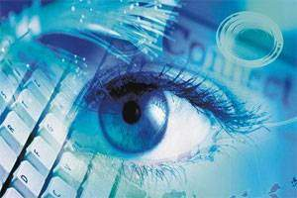
B L U E E Y E T E C H N O L O G Y
Human cognition depends primarily on the ability to perceive, interpret, and integrate audio-visuals and censoring information.
Adding extraordinary perceptual abilities to computers would enable computers to work together with human beings as intimate partners.
Researchers are attempting to add more capabilities to computers that will allow them to interact with humans, recognize human presents, talk, listen, or even guess their feelings.

Slide 6
Blue Eyes system consists of a mobile measuring device called Data Acquisition Unit (DAU) and a central analytical system called Central System Unit (CSU) interconnected by Bluetooth.
DAU collects information from the sensor and sends it over the Bluetooth and delivers the messages sent from CSU to the operator.
CSU buffers incoming sensor data and provides visualization interface.
The Blue Eyes system has hardware with software loaded on it Blue Eyes system can be applied in every working environment requiring permanent operators attention for it.
The hardware comprises of DAU and CSU.

Slide 7
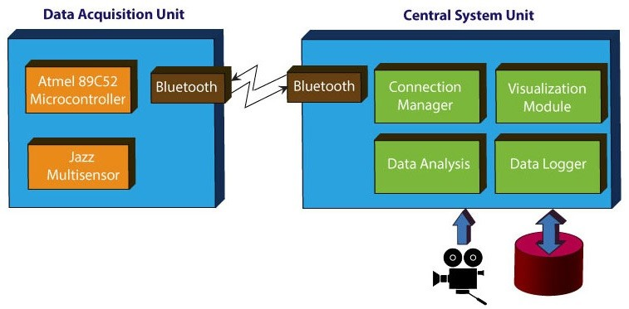
The following picture gives an overview of the Blue Eyes Technology.

Slide 8
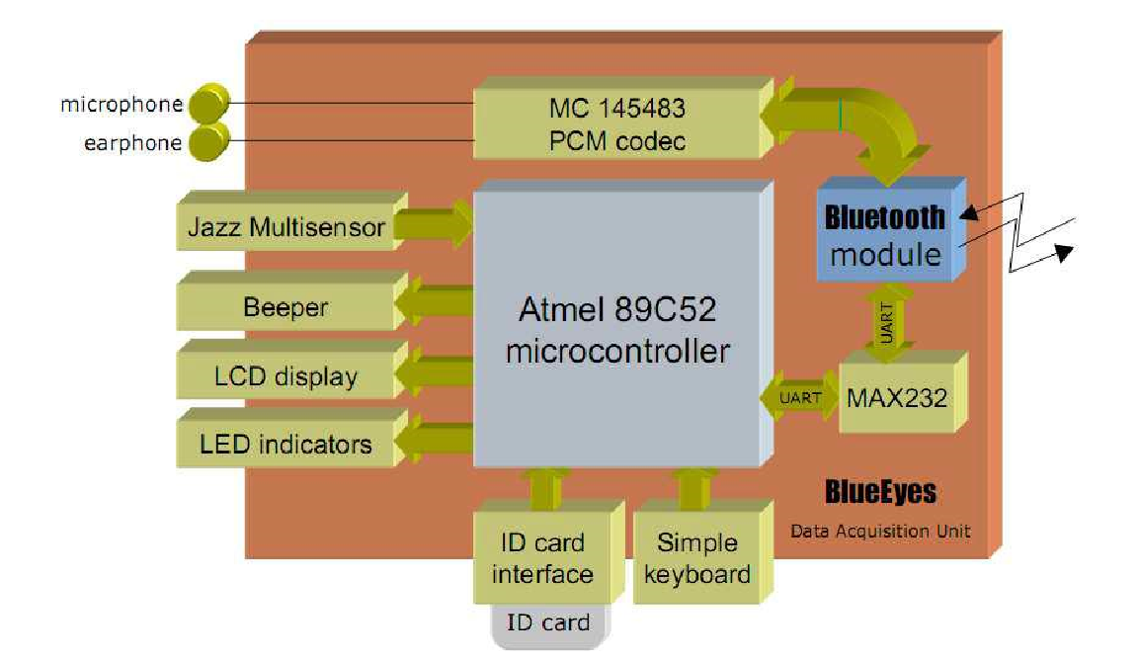
The Data Acquisition Unit comprises several hardware modules:
Atmel 89C52 microcontroller - system core
Bluetooth module (based on ROK101008)
HD44780 - small LCD display
24C16 - I2C EEPROM (on a removable ID card)
MC145483 – 13bit PCM codec
Jazz Multisensor interface
Beeper and LED indicators ,6 AA batteries and voltage level monitor

Slide 9
A D V A N C E D T R E N D S
The Blue Eyes technology aims at creating computational machines that have perceptual and sensory ability like those of human beings.
It uses non-obtrusive sensing method, employing most modern video cameras and microphones to identify the user’s actions through the use of imparted sensory abilities.
The machine can understand what a user wants, where he is looking at, and even realize his physical or emotional states.
The Blue Eyes Technology developed is intended to be a complex solution for monitoring and recording the operator’s conscious brain involvement as well as his/her physiological condition.
This shows yet another development in the field of Brain Computer Interface.

Slide 10
T E R M I N O L O G Y
Terminology of Blue Eyes:
Blue in this term stands for Bluetooth, which enables reliable wireless communication and the‚ Eyes because the eye movement enables us to obtain a lot of interesting and important information.
As the idea is to monitor and record operators basic physiological parameters, the most important physiological activity is the movement of eyes.
For a computer to sense the eye movement, wiring between the operator and the system is required.
But, this is a serious limitation of the operator’s mobility and disables his operations in large control rooms.
So utilization of wireless technology becomes essential which can be implemented through Bluetooth technology.

Slide 11
I Suggest you to read these too!!
https://tinyurl.com/jej3au8s
https://tinyurl.com/t97azxj4

Slide 12
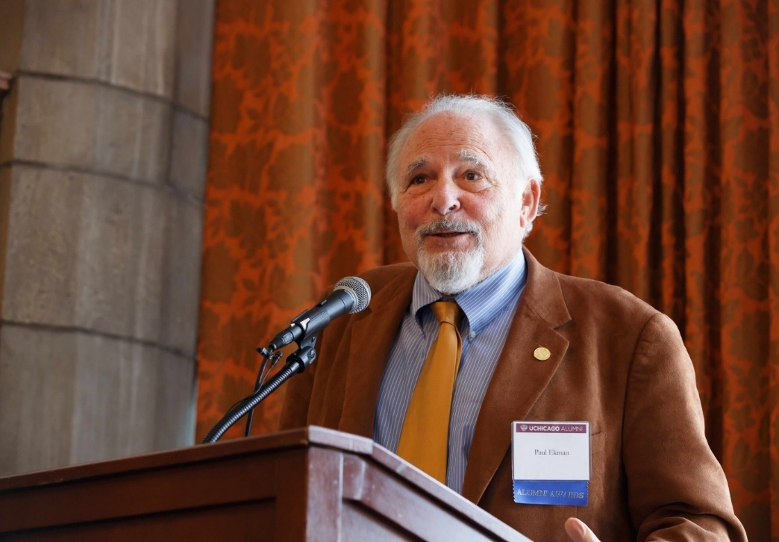
H I S T O R I C A L B A C K G R O U N D
Paul Ekman’s facial expression work gave the correlation between a person’s emotional state and a person’s physiological measurements, which described Facial Action Coding System (Ekman and Rosenberg, 1997).
His experiment involved participants attached to devices to record certain measurements including pulse, galvanic skin response (GSR), temperature and somatic movement.

Slide 13
H I S T O R I C A L B A C K G R O U N D
Experiment:
The experiment involves devices attached to participants to record certain measurements including pulse, galvanic skin response (GSR), temperature and somatic movement.
Six participants were trained to exhibit the facial expressions of the six basic emotions, anger, fear, sadness, disgust, joy and surprise.
The physiological changes associated with affect were assessed and analyzed.
Because of our need to incorporate these measurements into a small, non-intrusive form, we will explore taking these measurements from the hand, which requires an emotional sensor such as a mouse.

Slide 14
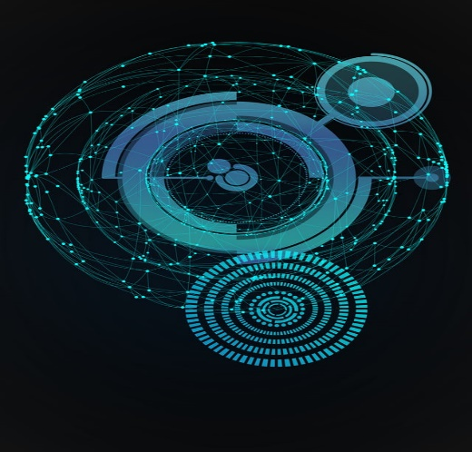
H I S T O R I C A L B A C K G R O U N D
B) Results:
The first analysis used multidimensional scaling (MDS) procedure to determine the dimensionality of the data and suggested that the physiological similarities and dissimilarities of the six emotional states fit within a four-dimensional model.
In the second analysis, discriminant function analysis was used to determine the mathematic function that would distinguish the six emotional state which suggested that all four physiological variables are sufficient to distinguish the six states.

Slide 15
N E E D S O F B L U E E Y E T E C H N O L O G Y
Some Common needs are,
Human error is still one of the most frequent causes of catastrophes (calamity) and ecological disasters because the human contribution to the overall performance of the system is left unsupervised.
The control instruments within the machine have automated it to large extent, thus Human operator becomes a passive observer of the supervised system, resulting in weariness and vigilance drop, but the user needs to be active.
The user may not notice important changes of indications causing financial or ecological consequences, which is a threat to human life. Thus, it is crucial that operators brain is involved in an active system supervising over the whole work time period.

Slide 16
B E N I FI TS O F B L U E E Y E T E C H N O L O G Y
Benefits of Blue Eye Technology:
Blue Eyes system provides technical means for monitoring and recording human operators physiological condition
Visual attention monitoring (eye motility analysis)
Physiological condition monitoring (pulse rate, blood oxygenation), operator’s position detection (standing, lying)
Physiological data, operator’s voice and overall view of the control room recording recorded data playback

Slide 17
B E N E F I T S O F B L U E E Y E T E C H N O L O G Y
Blue Eyes system can be applied in every working environment requiring permanent operator’s attention:
At power plant control rooms
Flight control centers
Professional drivers
“INTERESTING?”

Slide 18
N E E D S O F B L U E E Y E T E C H N O L O G Y
“Remember that the polygraph test is not a lie detector. It only detects emotional arousal.”
-
Paul Ekman, American psychologist.

Slide 19

A D V A N T A G E S
Advantages of Blue Eye Technology:
High accuracy level
Fast in speed
Naturalness as compared to the old traditional pointing
Less physical effort and stress as compared to manual pointing

Slide 20
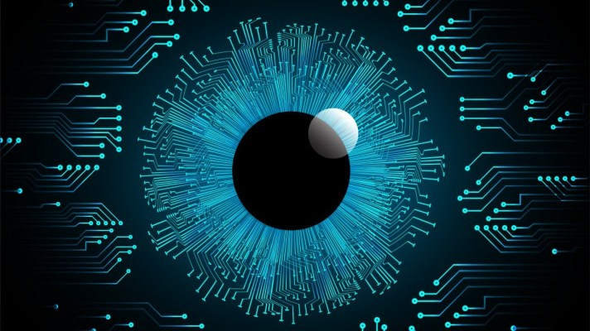
D I S A D V A N T A G E S
Disadvantages of Blue Eye Technology:
Distraction while Reading
Reliability of the system
Needs a minimization and system will be bulky
More Expensive
Not 100% Accurate.

Slide 21
A P P L I C A T I O N S
Applications of the Blue Eye Technology:
In every working environment requiring permanent operator’s attention.
At power plant control rooms.
At flight control centers.
In video games.
In Automobile industry.

Slide 22
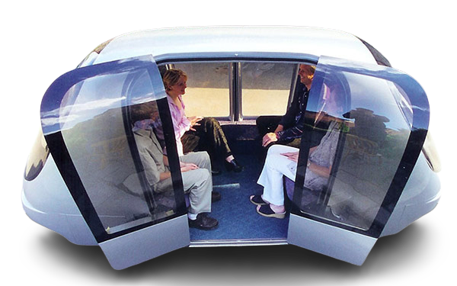
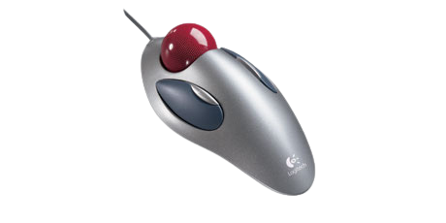
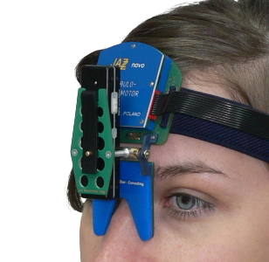
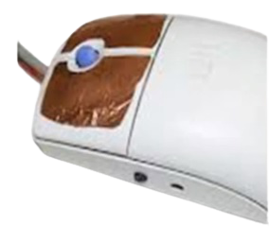
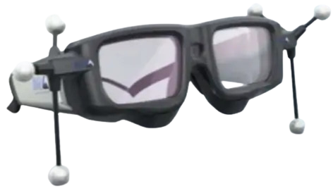

BLUE EYE TECHNOLOGY ENABLED DEVICES
Emotional Mouse
POD Car
Jazz Multisensor
SUITOR
SENTIC Mouse
Expression glasses

Slide 23

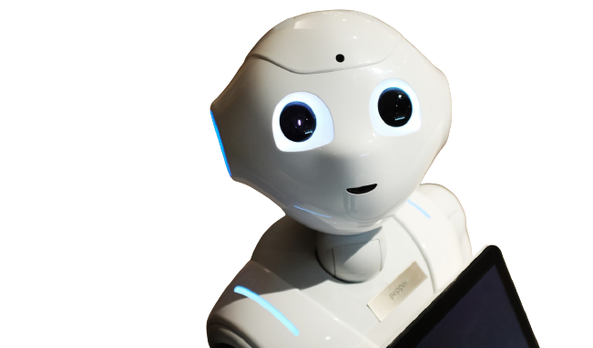
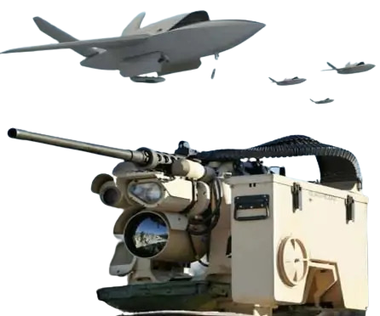
BLUE EYE TECHNOLOGY ENABLED DEVICES
MAGIC
ASIR
PONG Robot

Slide 24
F U T U R E T R E N D S
Future of the blue eye technology:
The future a blue eye technology is that it can be used in ordinary household devices also like in televisions refrigerators and ovens and may be able to do their jobs when we look at them and speak to them.
It also provides some more delicate and user friendly facilities in computing devices. it provides gap between the electronic and the physical world will be reduced.
The computers can be also run using implicit commands instead of the explicit commands.

Slide 25
CONCL U S I ON
In this session, we learned about:
Provide more delicate and user-friendly facilities in computing devices.
Better to use,instead of using cumbersome modules to gather information about user.
Meant to be a stress reliever.
Can cover areas such as industry, transportation, military or operation theaters.
Question: What is the main difference between Blue Eye Technology and Robotics?
https://tinyurl.com/5aj8uffj

